Slide 1
Informative Speech Presentation
Youth Crimes

Slide 2
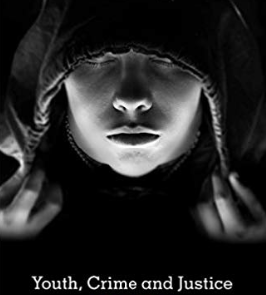
Introduction
Youth crime refers to the participation of illegal behaviors by minors.
Youth is also called juvenile delinquency or juvenile offending (Goldson & Muncie, 2015).
Youth crime is among the leading violators of wellness amid teens (Acland, 2018).
Most legal systems have established accurate procedures for dealing with juveniles.
Youth crimes are facilitated by many causes.
Notes:
Youth crime, also called juvenile delinquency or juvenile offending refers to the participation of illegal behaviors by minors (Acland, 2018). Youth crime is among the leading violators of wellness amid teens since they bring about varied effects. However, most legal systems have established accurate procedures for dealing with juveniles (Goldson & Muncie, 2015). Youth crimes are facilitated by many causes, such as being neglected as well as being bullied.

Slide 3
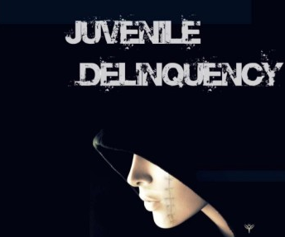
Root Causes of Youth Crime.
Financial hardship (Goldson & Muncie, 2015).
Peer pressure (Howell, 2019).
Lack of affection from family
Bullying.
Drug and alcohol abuse.
Notes:
Youth crime is featured with varied root causes (Howell, 2019). As evident financial hardships make teens start looking for convenient ways to address or bridge their financial gap. Peer pressure is a leading cause of juvenile delinquency where teens copy behavioral patterns of their friends. Lack of affection from family make teens become angry and violent (Goldson & Muncie, 2015). Bullying and other abusive behaviors open the door for crimes. Drug abuse and alcohol abuse lead to various crimes as a result of poor judgment.

Slide 4
Alternative Solutions for Youth Crime.
Youth crime can be addressed through;
Proper parenting
Juvenile justice systems (Howell, 2019).
Guidance and counseling.
Establishment of early intervention policies.
Selected Alternative Solution.
Juvenile justice system.
Notes:
Youth crime is on the verge of becoming a real threat. According to studies, one of the leading root causes of juvenile delinquency is the family (Howell, 2019). Parents should be keen on the most immediate elements of socialization that teens identify with. The juvenile justice system should launch juvenile friendly programs that would deter delinquency with reduced harms to teens. Guidance enables teens to identify with the right behavior. Early interventions would help to address juvenile behaviors soon as they occur.
The juvenile justice system is the most appropriate alternative solution for juvenile crime. Herein, juveniles should be held accountable for their criminal actions in an effort to ensure that they practice doing what is moral in society. Juvenile diversion programs should be established to deter unnecessary suffering amid teens.

Slide 5
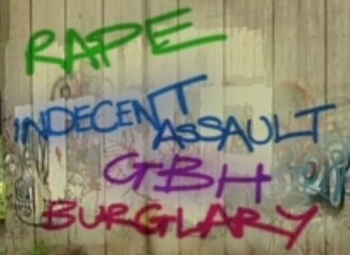
Implementation of the Solution
The juvenile justice system is a prime role of the central government by availing;
  Juvenile justice facilities (Thornberry et al., 2019).
  Juvenile justice proceedings (Allen & Superle, 2016).
  Juvenile right to appeal.
Notes:
The juvenile justice system is a prime role of the central government. It should ensure effectiveness in these control systems by establishing juvenile justice facilities (Allen & Superle, 2016). Providing qualifies juvenile attorneys to lead juvenile justice proceedings. Delinquent juveniles should be given the right to appeal (Thornberry et al., 2019).

Slide 6

Evaluation of the Implemented Alternative
Examining incidences of bias in judgment.
Ease of growing appeal (Harris, 2019).
Screening for recidivism.
Notes:
In a fully implemented juvenile justice system, judgment should be made on a fairground with necessary actions being put in place (Harris, 2019). An excellent juvenile justice system should give teens the chance to appeal to their judgment. The judgment outcome should not lead to additional crimes.

Slide 7
Conclusion
Youth crime refers to the participation of illegal behaviors by minors (Gill et al., 2018).
Youth crime can be addressed through proper parenting and juvenile justice systems.
The juvenile justice system is a prime role of the central government.
Providing qualifies juvenile attorneys to lead juvenile justice proceedings.

Slide 8
References
Acland, C. R. (2018). Youth, Murder, Spectacle: The Cultural Politics Of"" Youth in Crisis"". Routledge.
Allen, M. K., & Superle, T. (2016). Youth crime in Canada, 2014. Juristat: Canadian Centre for Justice Statistics, 1.
Gill, C., Weisburd, D., Vitter, Z., Gross Shader, C., Nelson-Zagar, T., & Spain, L. (2018). Collaborative problem-solving at youth crime hot spots: a pilot study. Policing: An International Journal, 41(3), 325-338.
Goldson, B., & Muncie, J. (Eds.). (2015). Youth crime and justice. Sage.
Harris, C. W. (2019). Matching Services to Needs: Drug Testing Youth in Diversion Programs (Doctoral dissertation, University of Nebraska at Omaha).
Howell, J. C. (2019). Youth Gangs: Nationwide Impacts of Research on Public Policy. American Journal of Criminal Justice, 1-17.

Slide 9
Presented by…

